Slide 1


Affirmatively Furthering Fair Housing in Marina
Workshop #2: March 15, 2023

Slide 2
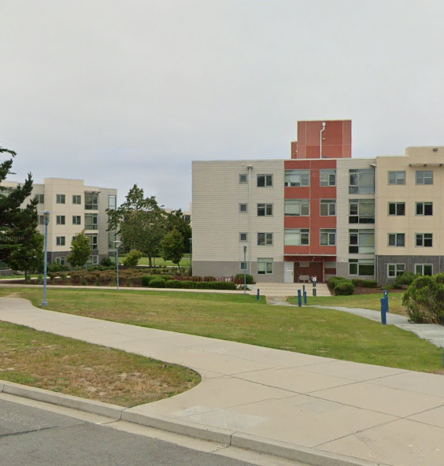
Project Team
City of Marina
Guido Persicone, Community Development Director
Consultant Team
Rincon Consultants, Inc
Veronica Tam and Associates, Inc.

Slide 3
Housekeeping Items
Technology happens – please be flexible and patient!
Discussion/Q&A at the end of the workshop.
Please mute yourself when you are not speaking.
Use the chat feature if you have any questions or comments during the presentation.
One person speaks at a time. Keep comments brief. You may turn on or keep your camera off when speaking.

Slide 4
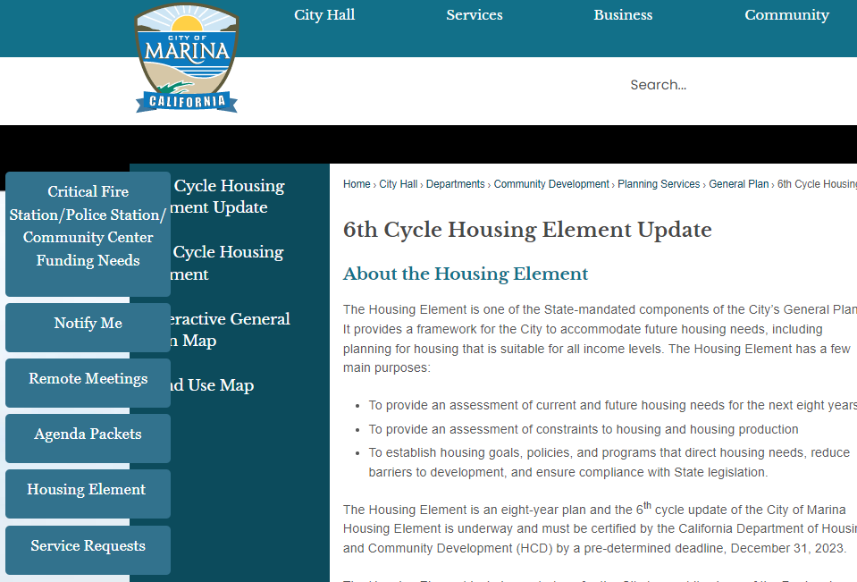

Housing Element Update Materials
Project website will include all information on the project, upcoming events, and the Draft Housing Element for review
https://cityofmarina.org/1186/6th-Cycle-Housing-Element-Update

Slide 5
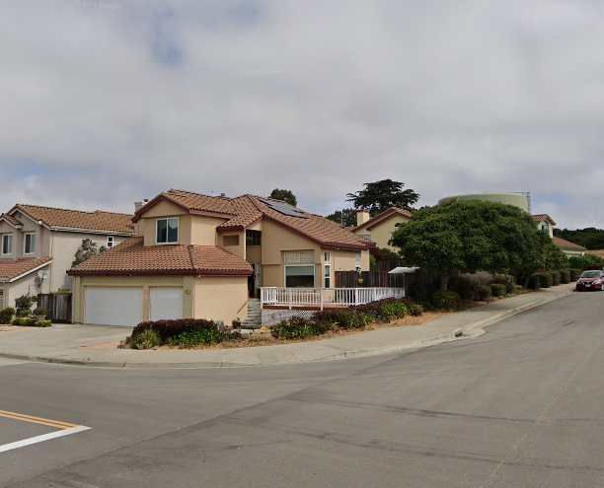
Agenda
Welcome and Introductions
AFFH Presentation
Discussion and Q&A
Get Involved and Next Steps
6:30-6:40
7:10-7:50
7:50-8:00
6:40-7:10

Slide 6
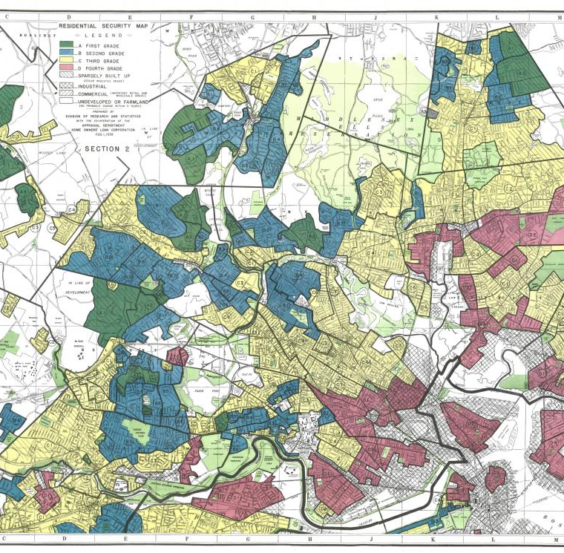
Housing Element and Fair Housing Basics

Slide 7
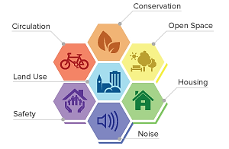
What is a Housing Element?
One of eight mandatory elements of the General Plan
Governed by California Government Code Article 10.6 (Sections 65580-65589.11)
Updated every 8 years
Only element that MUST be approved and certified by State

Slide 8
AFFH
Fair Housing Issues
Analyze fair housing issues with data, community input, and stakeholder interviews
Contributing Factors
Identify main, contributing factors that are leading to fair housing issues in the city.
Meaningful Actions
Include meaningful actions to address and overcome the identified fair housing issues/factors
“Taking meaningful actions, in addition to combating discrimination, that overcome patterns of segregation and foster inclusive communities free from barriers that restrict access to opportunity based on protected characteristics.”

Slide 9

AFFH Seeks to:
Combat housing discrimination
Eliminate racial bias
Undo historic patterns of segregation
Lift barriers that restrict access
Ultimately, foster inclusive communities and achieve racial equity, fair housing choice, and opportunity

Slide 10
Summary of New AB 686 Housing Element Requirements
Outreach
Assessment of Fair Housing
Sites Analysis
Priorities, Goals, and Actions
Notes:
New California regulations require fair housing to be incorporated throughout the Housing Element updates. This includes:
Targeted outreach to stakeholders and impacted communities
Robust fair housing analysis
Making sure the sites identified as opportunities for housing do not make conditions worse (concentrate lower income units in one location or near hazardous areas)
Establishing goals and actions to overcome conditions

Slide 11
AFFH Areas of Analysis
Fair Housing Enforcement and Outreach Capacity
Patterns of Segregation and Integration
Disparities in Access to Opportunities
Disproportionate Housing Needs/Displacement Risk
Racially Concentrated Areas of Poverty and Affluence

Slide 12
Fair Housing Enforcement and Outreach
Ability to disseminate information related to fair housing
Provide outreach and education to ensure residents know their rights
Ability to address compliance with fair housing laws
The City works with Eden Council for Hope and Opportunity and the Housing Authority
There have been 19 fair housing inquires between 2013-2021
Stakeholders and residents have expressed housing discrimination issues based on:
Having a disability
Using Section 8 Vouchers
Notes:
During previous community outreach, residents explained their experience being discriminated against for having a disability or using Section 8 Vouchers.

Slide 13
Discussion Questions: Fair Housing
Do you feel informed and aware of your options if Fair Housing rights are violated?
How do you think the City should enforce or prevent fair housing discrimination?
Are there areas of the city that efforts to address this should focus?

Slide 14
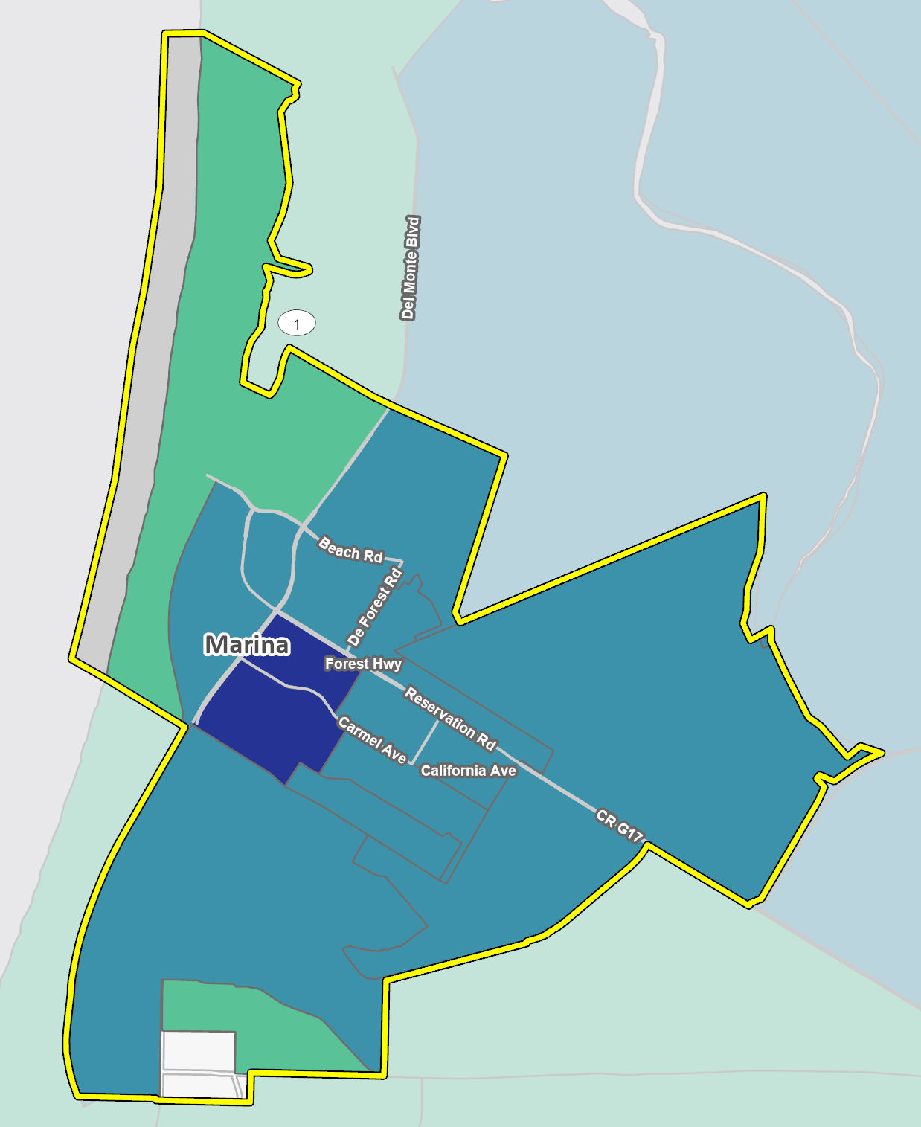
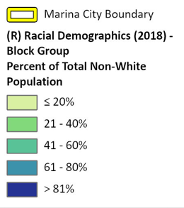
Integration and Segregation Patterns and Trends
Assessment of segregation and integration in city based on:
Race/Ethnicity
Familial Status
Income
Persons with Disabilities
In Marina, the city is primarily segregated based on race and income. Areas east of Del Monte Blvd and south of Reservation Road are more diverse and had a lower median income.
Notes:
East of Del Monte Boulevard generally shows more diversity. Downtown area is most diverse. The whole city is a moderate resource area due to distance from jobs, but no areas of the city are low resource.

Slide 15
Discussion Questions
Do you feel that Marina is segregated in any way, based on these categories?
What groups are most impacted by this segregation?
Do you have any ideas for how to better integrate areas?
Categories:
Race/Ethnicity
Familial Status
Income
Persons with Disabilities

Slide 16
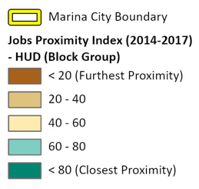
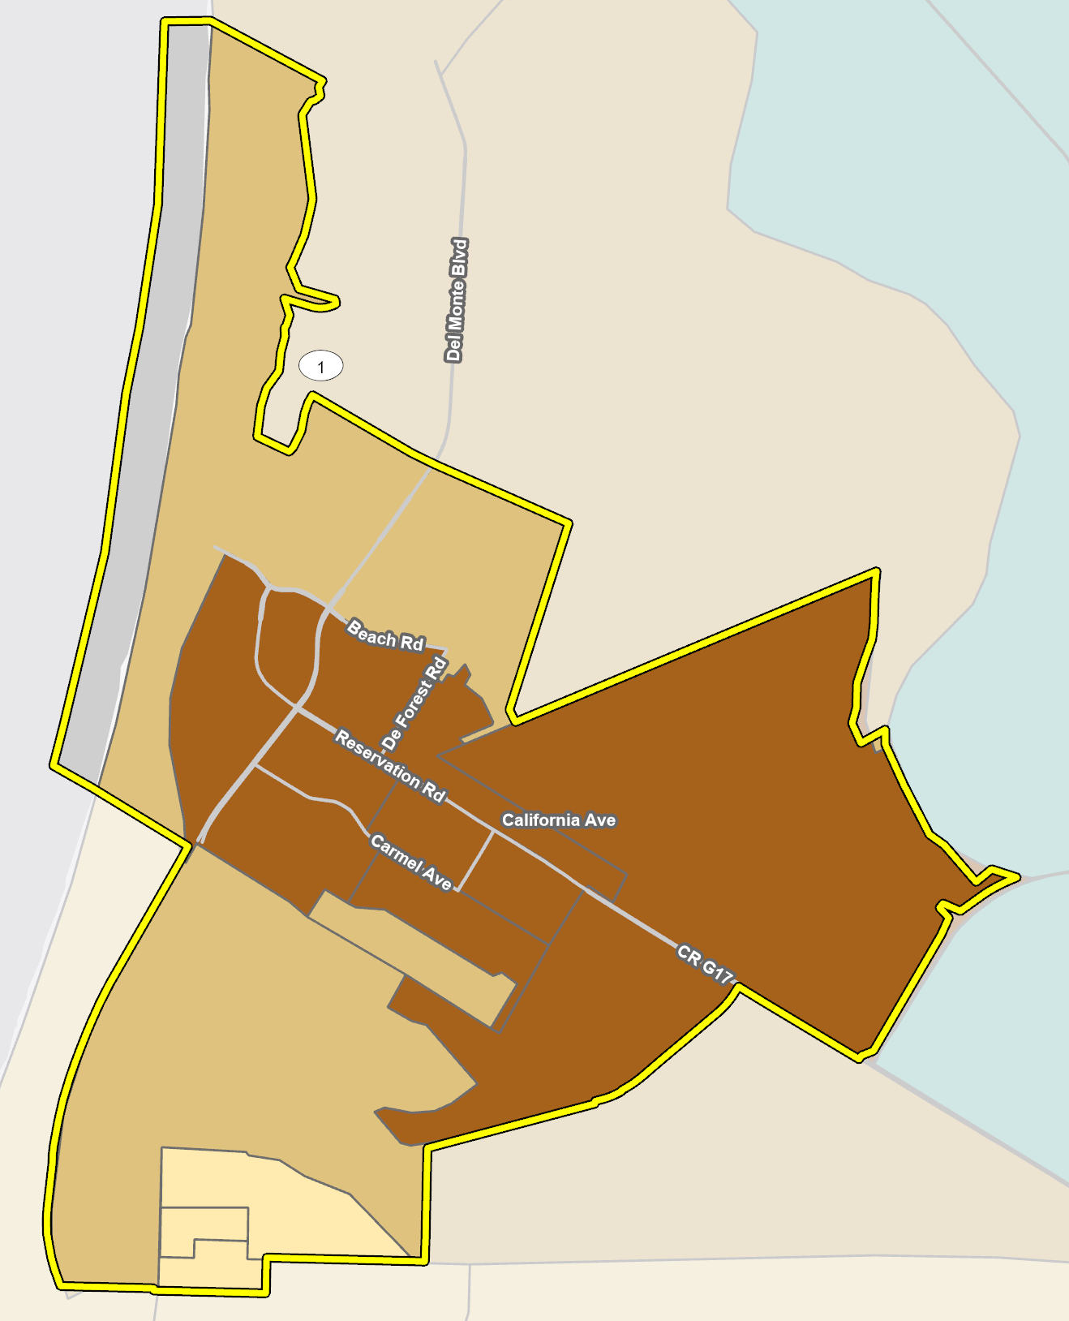
Disparities in Access to Opportunities
Assessment of any inequality in access to opportunities to:
Education
Economic Development and Employment
Transportation/Access to Needs
Healthy Environment
In Marina, much of the City has a low job proximity which the central areas of the City having the lowest economic opportunity. Most of the City also has a lower education outcome.

Slide 17
Discussion Questions: Access
What areas of the city do you feel have inequal access and to what?
Are there environmental issues that impact certain areas more (air quality, noise, etc.)?
What types of improvements to access to opportunities would you like the City to prioritize?
Categories in Access:
Education
Economic Development and Employment
Transportation/Access to Needs
Healthy Environment

Slide 18
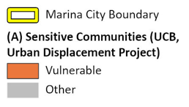
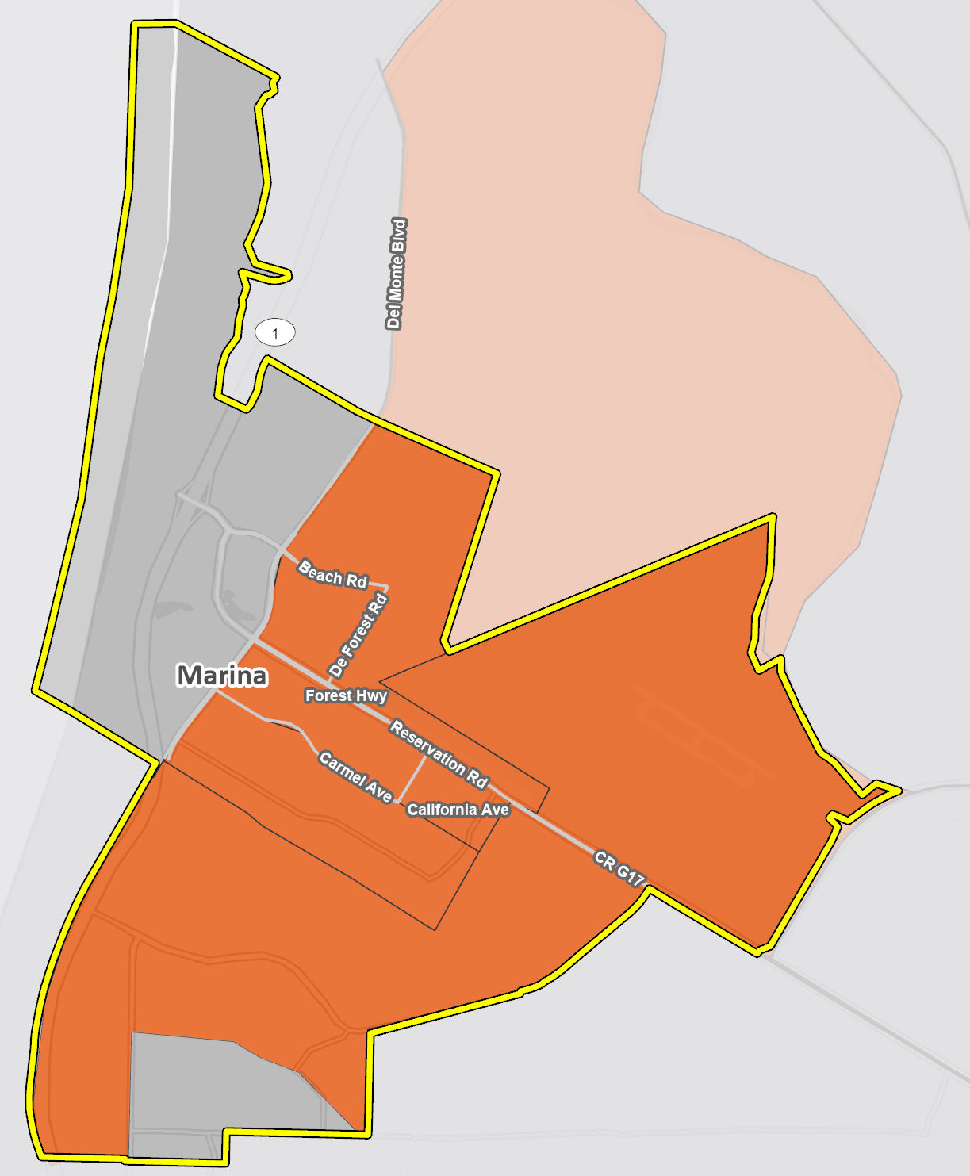
Disproportionate Housing Needs
This fair housing topic looks at whether certain populations are having a type of housing need/issue greater than members of other groups. It looks at:
Overcrowding
Cost Burden (spending >30% income on housing)
Housing conditions
Homelessness
In Marina, about 40% of households are cost burdened. Most areas of the city are vulnerable to displacement which can impact lower income and at-risk households.
There is a need for landlords to maintain rental housing in better conditions in Marina.
Notes:
Coastal jurisdictions tend to be more cost-burdened. A large portion of the City is vulnerable to displacement.

Slide 19
Discussion Questions: Housing Needs
Are there areas of the city that have substandard housing?
How can the City help prevent or address displacement risk?
What other types of housing need needs do you think are an issue in the city?

Slide 20
Fair Housing Issues
In the chat please state what you think the most important fair housing issue in the city
Fair Housing Enforcement
Patterns of Segregation
Disparities in Access to Opportunities
Disproportionate Housing Needs/Displacement Risk
Racially Concentrated Areas of Poverty and Affluence (non in Marina)
Notes:
Please choose the top fair housing issue in Marina by category
Fair Housing Enforcement
Patterns of Segregation
Disparities in Access to Opportunities
Disproportionate Housing Needs/Displacement Risk
Racially Concentrated Areas of Poverty and Affluence

Slide 21

Next Steps

Slide 22
Tentative Schedule
Community Workshop 2
Site Inventory and Fair Housing
March 2023
Draft Housing Element for Public Review
April 2023
Public Hearings on Draft Housing Element
April-May 2023
Submit Housing Element to State HCD for review
June 2023

Slide 23





Stay Involved
Upcoming
Community Engagement
Survey
Written Comments
Formal Hearings
Notes:
The Housing Element update process is still on-going and additions and changes to the draft will continue over the next 6 months to a year as we get the Housing Element certified by the State. Stay involved in the process and make sure you’re visiting the website for upcoming events.
Potential pop-up outreach at community events
Online survey that will close March 22
Written comments on the draft Housing Element
Formal hearings in April and May

Slide 24
Thank you! Contact us with any questions or additional comments: Guido Persicone: gpersicone@cityofmarina.org Ryan Russell: rrussell@rinconconsultants.com

